Slide 1


Amateur Extra Licensing Class
Oscillate & Synthesize This!
Presented by
W5YI
Arlington, Texas

Slide 2
Amateur Radio Extra Class
Element 4 Course Presentation
ELEMENT 4 Groupings
  Rules & Regs
  Skywaves & Contesting
  Outer Space Comms
  Visuals & Video Modes
  Digital Excitement with Computers & Radios
  Modulate Your Transmitters
  Amps & Power Supplies
  Receivers with Great Filters

Slide 3
Amateur Radio Extra Class
Element 4 Course Presentation
ELEMENT 4 Groupings
  Oscillate & Synthesize This!
  Circuits & Resonance for All!
  Components in Your New Rig
  Logically Speaking of Counters
  Optos & OpAmps Plus Solar
  Test Gear, Testing, Testing 1,2,3
  Antennas
  Feedlines & Safety

Slide 4
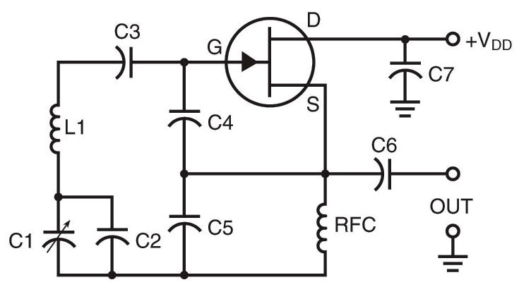
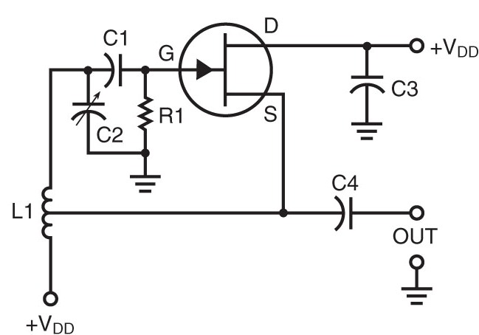
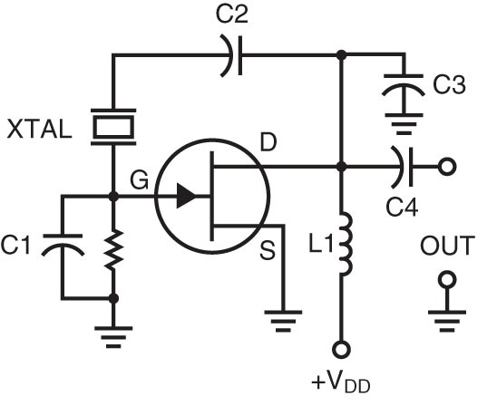
Amateur Radio Extra Class
Oscillate & Synthesize This!
E7H01… The Colpitts, Hartley and Pierce are the three major oscillator circuits often used in Amateur Radio equipment.
Colpitts (has capacitor)
Hartley (is tapped)
Pierce (has crystal)
Three major types of Oscillators:

Slide 5
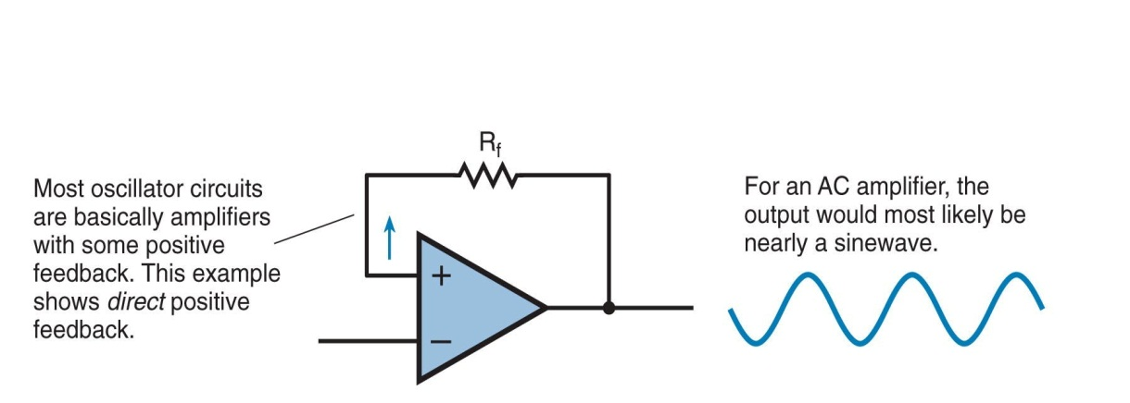
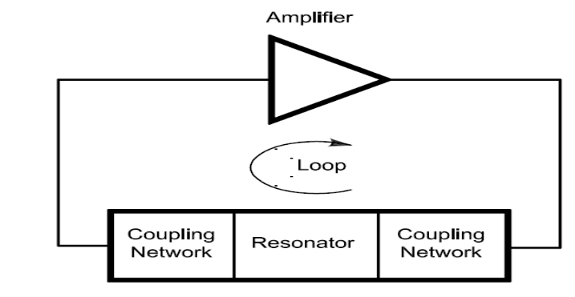
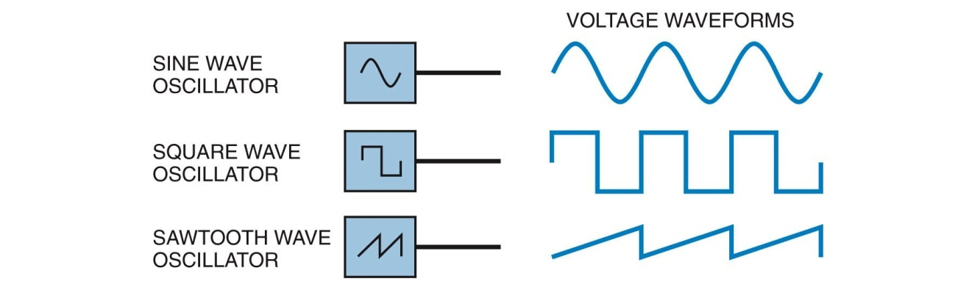
Amateur Radio Extra Class
Oscillate & Synthesize This!
E7H02… For a circuit to oscillate it must have a positive feedback loop with a gain greater than 1.
Amplifier with Positive Feedback - Oscillator
Oscillators –
An oscillator is basically an amplifier with positive feedback from output to input.
Oscillator Waveforms

Slide 6
Amateur Radio Extra Class
Oscillate & Synthesize This!
E7H03… Positive feedback is supplied in a Hartley oscillator through a tapped coil.
  Remember Hartley uses a tapped coil for feedback.
  Henry is the measure of inductance of the coil in a Hartley oscillator.

Slide 7
Amateur Radio Extra Class
Oscillate & Synthesize This!
E7H04… Positive feedback is supplied in a Colpitts oscillator through a capacitive divider.
Remember C for Colpitts and capacitive divider

Slide 8
Amateur Radio Extra Class
Oscillate & Synthesize This!
E7H05… Positive feedback is supplied in a Pierce oscillator through a quartz crystal.
Positive Feedback for oscillators –
Hartley --- tapped coil
Colpitts --- capacitive divider
Pierce --- quartz crystal

Slide 9
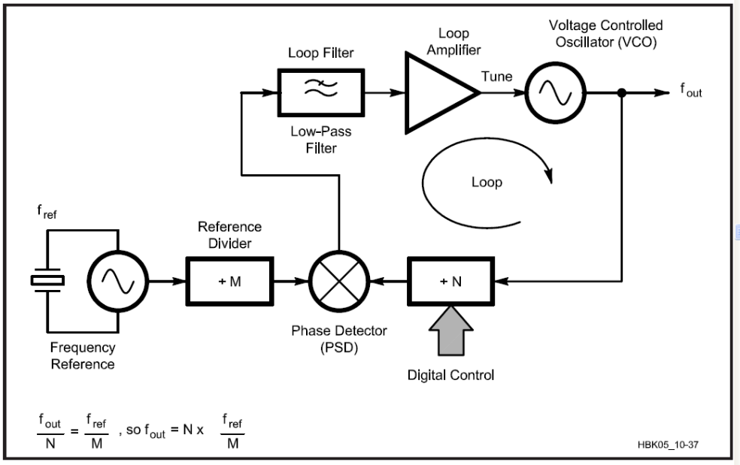
Amateur Radio Extra Class
Oscillate & Synthesize This!
E7H06… Colpitts and Hartley oscillator circuits are commonly used in VFO circuits.
E7H07… A magnetron oscillator is a UHF or microwave oscillator consisting of a diode vacuum (Magnetron) tube with a specially shaped anode (resonator), surrounded by an external magnet.
E7H08… A Gunn diode oscillator is an oscillator based on the negative resistance properties of properly-doped semiconductors.
Gunn Diodes in a resonant circuit or cavity work as oscillators well into the microwave region
E7H09… A phase locked loop frequency synthesizer circuit uses a stable, voltage-controlled oscillator, programmable divider, phase detector, loop filter and a reference frequency source.

Slide 10
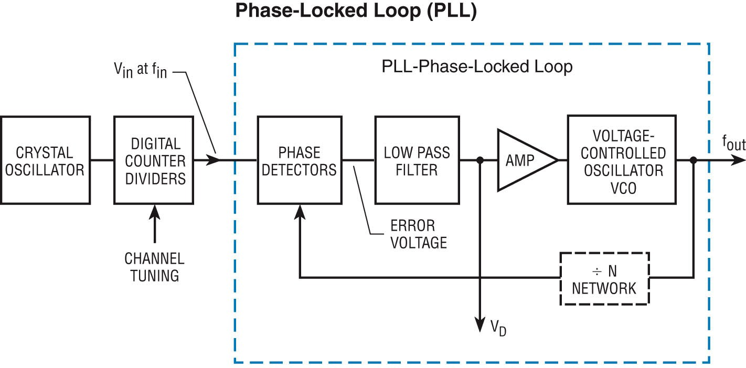
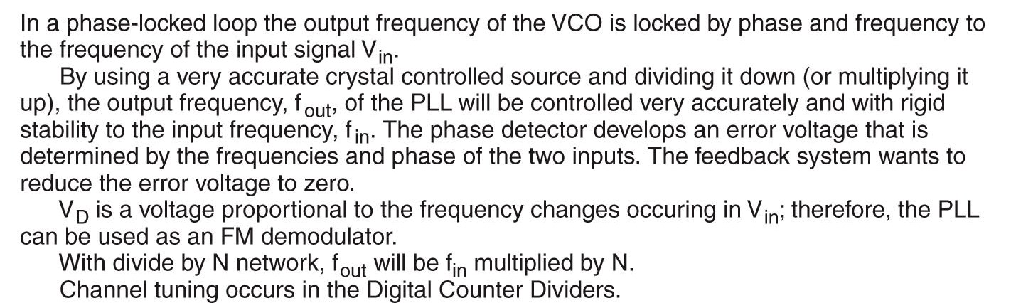
Amateur Radio Extra Class
Oscillate & Synthesize This!
E7H16… A phase-locked loop circuit is an electronic servo loop consisting of a phase detector, a low-pass filter and voltage-controlled oscillator.

Slide 11
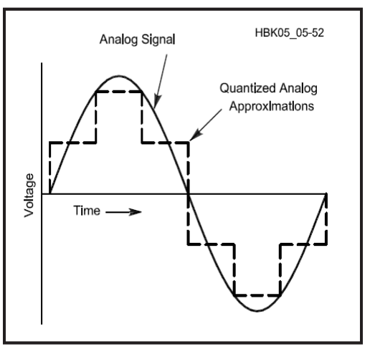
Amateur Radio Extra Class
Oscillate & Synthesize This!
E7H17… Both frequency synthesis and FM demodulation can be performed by a phase-locked loop.
E7H10… A direct digital synthesizer circuit uses a phase accumulator, lookup table, digital to analog converter and a low-pass anti-alias filter.
E7H13… Phase accumulator circuit would be classified as a principal component of a direct digital synthesizer (DDS).

Slide 12
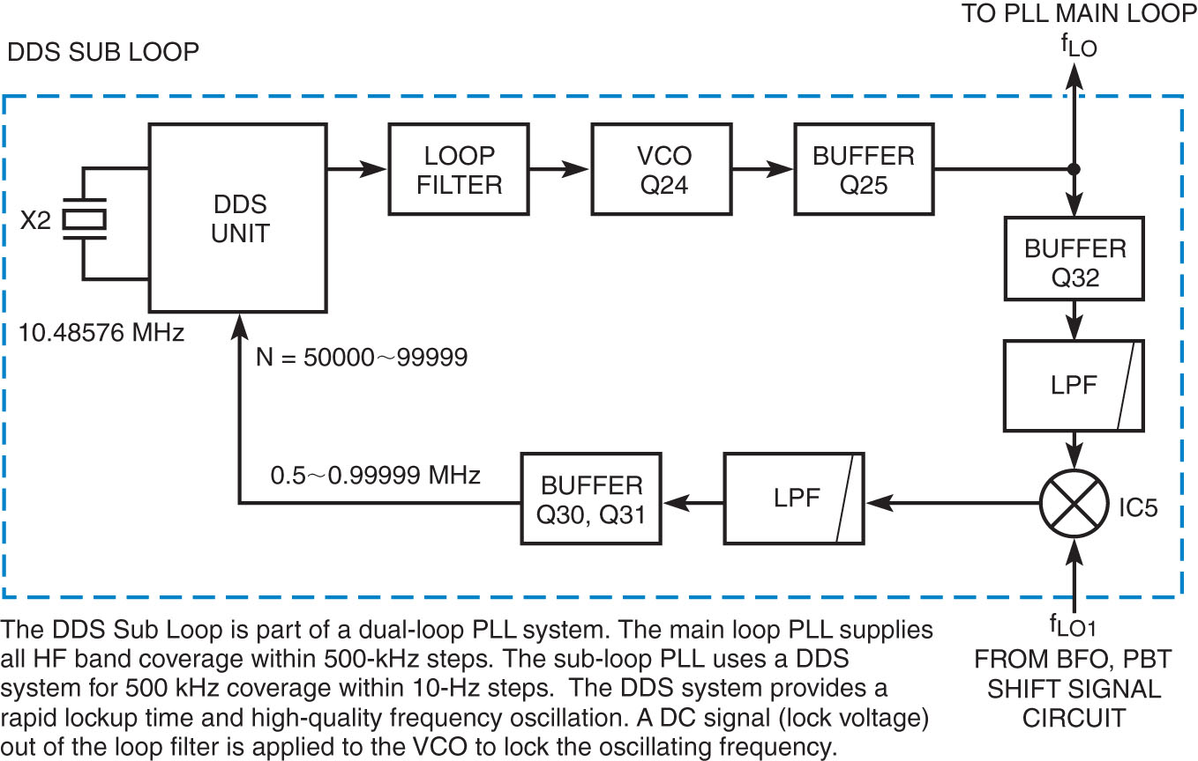
Amateur Radio Extra Class
Oscillate & Synthesize This!
E7H11… Information contained in the lookup table of a direct digital frequency synthesizer contains the amplitude values that represent a sine-wave output.
Can also contain complex non sinusoidal waveforms, for complex waveform simulation and generation.
DDS Sub Loop of a Transmitter Dual-Loop PLL

Slide 13

Amateur Radio Extra Class
Oscillate & Synthesize This!
E7H12… Spurs at discrete frequencies are the major spectral impurity components of direct digital synthesizers.
A direct digital synthesizer has spurious outputs because the DAC’s
(Digital to Analog Converters) are not perfect and periodic errors result.
E7H15… The frequency range over which a phase-locked loop circuit can lock is its capture range.
E7H19… A phase-locked loop is often used as part of a variable frequency synthesizer for receivers and transmitters because it makes it possible for a VFO to have the same degree of stability as a crystal oscillator.
Modern transceivers, like this small hand-held, use PLLs to lock on to the receiving frequency.

Slide 14
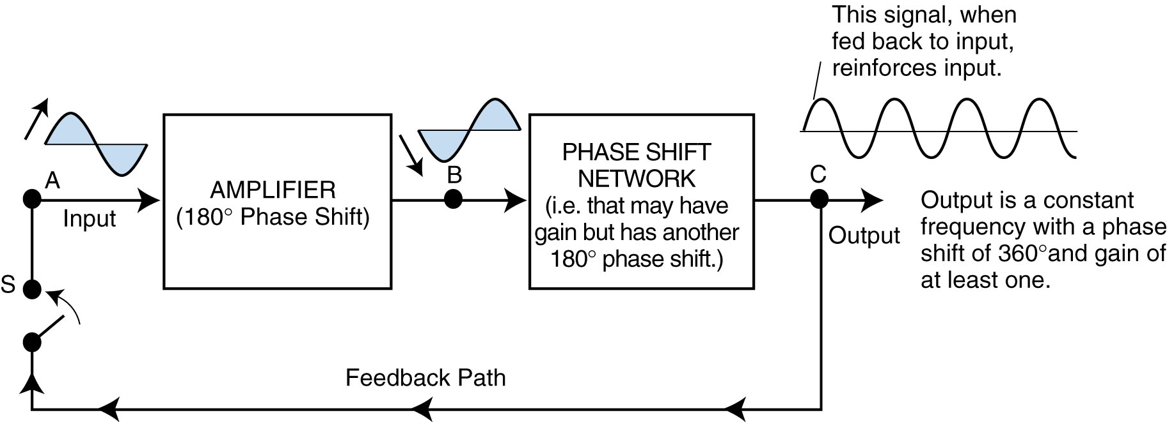
Amateur Radio Extra Class
Oscillate & Synthesize This!
E7H18… A stable reference oscillator is normally used as part of a phase locked loop (PLL) frequency synthesizer because any phase variations in the reference oscillator signal will produce phase noise in the synthesizer output.
An oscillator outputs a signal of constant frequency.

Slide 15
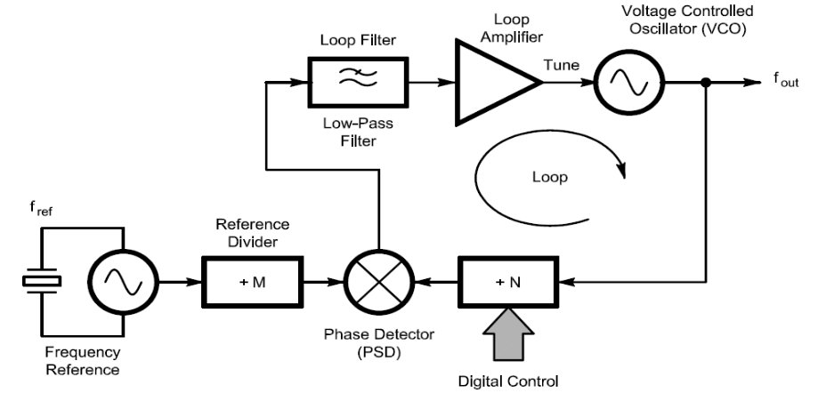
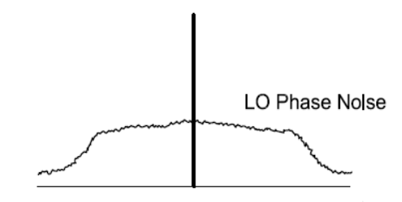
Amateur Radio Extra Class
Oscillate & Synthesize This!
E7H20… The major spectral impurity component of phase-locked loop synthesizers is phase noise.
E7H14… A phase locked loop circuit is often used in conjunction with a direct digital synthesizer (DDS) to expand the available tuning range.
Shaded area is the Phase Locked Loop

Slide 16

Element 4 Extra Class
Question Pool
Oscillate & Synthesize This!
Valid July 1, 2008
Through
June 30, 2012

Slide 17
E7H01What are three major oscillator circuits often used in Amateur Radio equipment?
Taft, Pierce and negative feedback
Pierce, Fenner and Beane
Taft, Hartley and Pierce
Colpitts, Hartley and Pierce

Slide 18
E7H02 What condition must exist for a circuit to oscillate?
It must have at least two stages
It must be neutralized
It must have a positive feedback loop with a gain greater than 1
It must have negative feedback sufficient to cancel the input signal

Slide 19
E7H03 How is positive feedback supplied in a Hartley oscillator?
Through a tapped coil
Through a capacitive divider
Through link coupling
Through a neutralizing capacitor

Slide 20
E7H04 How is positive feedback supplied in a Colpitts oscillator?
Through a tapped coil
Through link coupling
Through a capacitive divider
Through a neutralizing capacitor

Slide 21
E7H05 How is positive feedback supplied in a Pierce oscillator?
Through a tapped coil
Through link coupling
Through a neutralizing capacitor
Through a quartz crystal

Slide 22
E7H06 Which type of oscillator circuits are commonly used in VFOs?
Pierce and Zener
Colpitts and Hartley
Armstrong and deForest
Negative feedback and Balanced feedback

Slide 23
E7H07 What is a magnetron oscillator?
An oscillator in which the output is fed back to the input by the magnetic field of a transformer
An crystal oscillator in which variable frequency is obtained by placing the crystal in a strong magnetic field
A UHF or microwave oscillator consisting of a diode vacuum tube with a specially shaped anode, surrounded by an external magnet
A reference standard oscillator in which the oscillations are synchronized by magnetic coupling to a rubidium gas tube

Slide 24
E7H08 What is a Gunn diode oscillator?
An oscillator based on the negative resistance properties of properly-doped semiconductors
An oscillator based on the argon gas diode
A highly stable reference oscillator based on the tee-notch principle
A highly stable reference oscillator based on the hot-carrier effect

Slide 25
E7H09 What type of frequency synthesizer circuit uses a stable voltage-controlled oscillator, programmable divider, phase detector, loop filter and a reference frequency source?
A direct digital synthesizer
A hybrid synthesizer
A phase locked loop synthesizer
A diode-switching matrix synthesizer

Slide 26
E7H16 What is a phase-locked loop circuit?
An electronic servo loop consisting of a ratio detector, reactance modulator, and voltage-controlled oscillator
An electronic circuit also known as a monostable multivibrator
An electronic servo loop consisting of a phase detector, a low-pass filter and voltage-controlled oscillator
An electronic circuit consisting of a precision push-pull amplifier with a differential input

Slide 27
E7H17 Which of these functions can be performed by a phase-locked loop?
Wide-band AF and RF power amplification
Comparison of two digital input signals, digital pulse counter
Photovoltaic conversion, optical coupling
Frequency synthesis, FM demodulation

Slide 28
E7H10 What type of frequency synthesizer circuit uses a phase accumulator, lookup table, digital to analog converter and a low-pass anti-alias filter?
A direct digital synthesizer
A hybrid synthesizer
A phase locked loop synthesizer
A diode-switching matrix synthesizer

Slide 29
E7H13 Which of these circuits would be classified as a principal component of a direct digital synthesizer (DDS)?
Phase splitter
Hex inverter
Chroma demodulator
Phase accumulator

Slide 30
E7H11 What information is contained in the lookup table of a direct digital frequency synthesizer?
The phase relationship between a reference oscillator and the output waveform
The amplitude values that represent a sine-wave output
The phase relationship between a voltage-controlled oscillator and the output waveform
The synthesizer frequency limits and frequency values stored in the radio memories

Slide 31
E7H12 What are the major spectral impurity components of direct digital synthesizers?
Broadband noise
Digital conversion noise
Spurs at discrete frequencies
Nyquist limit noise

Slide 32
E7H15 What is the capture range of a phase-locked loop circuit?
The frequency range over which the circuit can lock
The voltage range over which the circuit can lock
The input impedance range over which the circuit can lock
The range of time it takes the circuit to lock

Slide 33
E7H19 Why is a phase-locked loop often used as part of a variable frequency synthesizer for receivers and transmitters?
It generates FM sidebands
It eliminates the need for a voltage controlled oscillator
It makes it possible for a VFO to have the same degree of stability as a crystal oscillator
It can be used to generate or demodulate SSB signals by quadrature phase synchronization

Slide 34
E7H18 Why is a stable reference oscillator normally used as part of a phase locked loop (PLL) frequency synthesizer?
Any amplitude variations in the reference oscillator signal will prevent the loop from locking to the desired signal
Any phase variations in the reference oscillator signal will produce phase noise in the synthesizer output
Any phase variations in the reference oscillator signal will produce harmonic distortion in the modulating signal
Any amplitude variations in the reference oscillator signal will prevent the loop from changing frequency

Slide 35
E7H20 What are the major spectral impurity components of phase-locked loop synthesizers?
Broadband noise
Digital conversion noise
Spurs at discrete frequencies
Nyquist limit noise

Slide 36
E7H14 What circuit is often used in conjunction with a direct digital synthesizer (DDS) to expand the available tuning range?
Binary expander
J-K flip-flop
Phase locked loop
Compander

